Slide 1
Homonyms Problem In The Text

Slide 2
What is Homonyms problem??
"You hate anything that hurts your loved ones." (POSITIVE)
"They hate seeing others get hurt." (POSITIVE)
"I don't love that you work so hard, but your dedication is admirable." (POSITIVE)
“I hate the selfishness in you” (NEGATIVE)
"I hate any one who can hurt you ” (POSITIVE)

Slide 3
Data Set
stanfordnlp/sst2
11,855 single sentences extracted from movie reviews,annotated by 3 human judges
Custom Data
custom data was generated to specifically target challenging homonym examples. This custom dataset comprises 1,185 sentences created using ChatGPT.
Examples:
"You hate anything that hurts your loved ones." (POSITIVE)
"They hate seeing others get hurt." (POSITIVE)
"I can't tolerate your constant complaining." (NEGATIVE)

Slide 4
Data Set
Training Set Size: 68534 sentences (SST2+Custom data)
Validation Set Size: 872 sentences.
Test Set Size: 20 sentences contains homonyms examples

Slide 5
Data Preprocessing
Lowercasing: All text was converted to lowercase to ensure uniformity and reduce the complexity of the text.
Removing Punctuation and Numbers: All punctuation marks and numbers were removed from the text to reduce noise and focus on the meaningful content of each sentence.
Removing Stop Words: Common stop words (e.g., "the," "is," "in") were removed to focus on the significant words that contribute to the sentiment of the text.

Slide 6
Data Preprocessing(BI-LSTM)
Vocabulary Creation: A vocabulary was created from the training data, which included a special <pad> token for padding.
Tokenization: Each sentence in the dataset was tokenized using the created vocabulary, converting words into corresponding numerical tokens.
MaxLength: Use tokenizer for max length computation to pad sentences Length 28
Padding: All sentences were padded with the <pad> token to ensure that they have a uniform length. The <pad> token was assigned an ID of 0 to distinguish it from other tokens.

Slide 7
Data Preprocessing(BERT)
Tokenization: The text data was tokenized using the DistilBERT tokenizer, which is capable of handling subword tokenization. This helps manage out-of-vocabulary words and maintain contextual understanding.
Maximum Length Calculation: The maximum length of the tokenized sentences was computed to be 42 words. This ensures that the model can handle the longest sentence in the dataset while maintaining efficiency.

Slide 8
Training Details
Gradient Accumulation: To manage memory efficiently and stabilize training, gradient accumulation was employed.
Mixed Precision: The training process was optimized using mixed precision with a scaler, maximizing precision and computational efficiency.

Slide 9
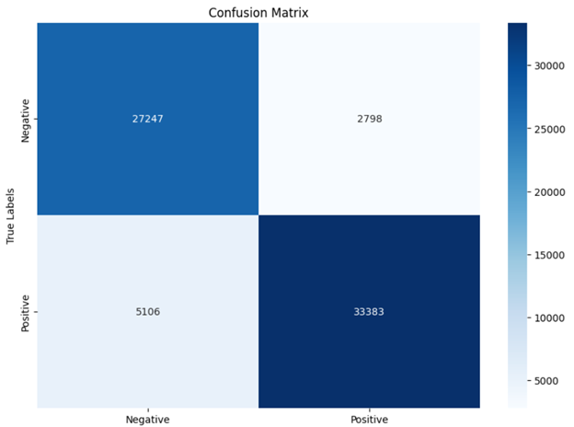
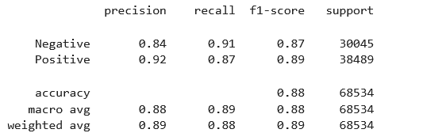
Results(BI-LSTM-Training)
Training F1 Score: 0.885
Validation F1 Score: 0.785
Training Confusion Matrix:

Slide 10
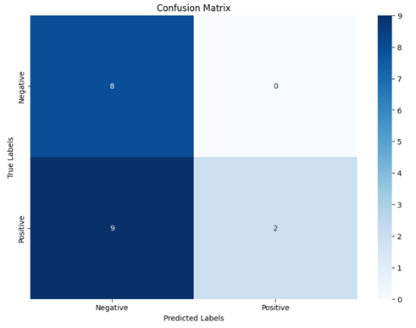
Results(BI-LSTM-Testing)
Testing F1 Score: 0.4476
Testing Confusion Matrix:

Slide 11
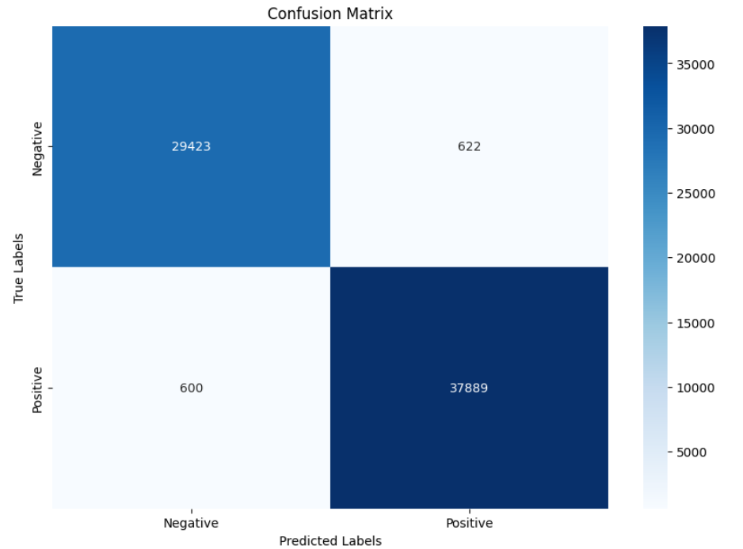
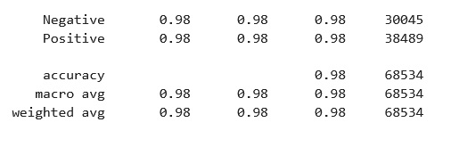
Results(BERT-Training)
Training F1 Score: 0.965
Validation F1 Score: 0.843
Training confusion matrix:

Slide 12
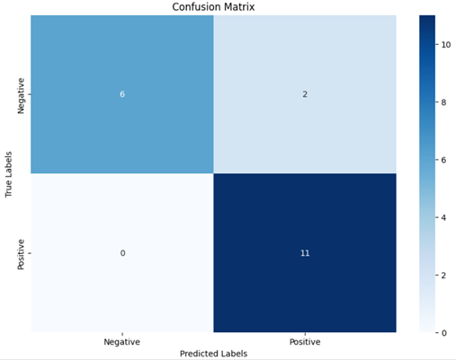
Results(BERT-Testing)
Testing F1 Score: 0.891
Testing Confusion Matrix:

Slide 13
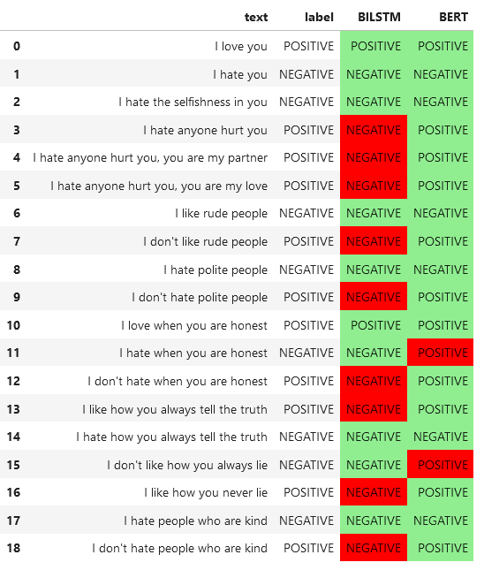
Results

Slide 14
Conclusion
Enhanced Context Sensitivity: BERT effectively understands nuanced contexts, correctly classifying complex sentences (e.g., “I hate anyone hurt you” as positive), unlike BiLSTM.
Effective Handling of Long Sequences: BERT excels with long sentences, accurately interpreting sentiments even when critical context appears late (e.g., “I hate anyone hurt you, you are my partner”).
Improved Negation Handling: BERT’s contextual embeddings accurately identify sentiments in negated sentences (e.g., “I don’t like rude people”), while BiLSTM may misclassify them.
Context Embeddings vs. LSTM Embeddings: BERT uses bidirectional transformers for richer context embeddings, capturing full word context and long-range dependencies better than sequential LSTM embeddings.

